Slide 1
INT219 Front End Web Developer

Slide 2
Unit I
Overview of HTML, CSS and JavaScript : Fundamentals of HTML, Creating Style Sheet, CSS Box Model- Border properties, Padding properties, Margin properties, Introduction to JavaScript, Working with Web Forms and validating user input, JavaScript functions and events, JavaScript Timing Events, JavaScript Image Slideshow, Recursive function in JavaScript, Error handling in JavaScript

Slide 3
HTML:
HTML stands for Hyper Text Markup Language.
HTML is the standard markup language for creating Web pages.
HTML describes the structure of a Web page.
HTML consists of a series of elements.
HTML elements tell the browser how to display the content.
HTML elements label pieces of content such as "this is a heading", "this is a paragraph", "this is a link", etc.

Slide 4
STRUCTURE:
<!DOCTYPE html>
<html>
<head>
<title>Page Title</title>
</head>
<body>
<h1>This is a Heading</h1>
<p>This is a paragraph.</p>
</body>
</html>

Slide 5
Explanation of Structure :
The <!DOCTYPE html> declaration defines that this document is an HTML5 document
The <html> element is the root element of an HTML page
The <head> element contains meta information about the HTML page
The <title> element specifies a title for the HTML page (which is shown in the browser's title bar or in the page's tab)
The <body> element defines the document's body, and is a container for all the visible contents, such as headings, paragraphs, images, hyperlinks, tables, lists, etc.
The <h1> element defines a large heading
The <p> element defines a paragraph

Slide 6
What is an HTML Element?
An HTML element is defined by a start tag, some content, and an end tag:
<tagname> Content goes here... </tagname>
The HTML element is everything from the start tag to the end tag:
<h1>My First Heading</h1>
<p>My first paragraph.</p>

Slide 7
Various Tags :
HTML Headings:
HTML headings are defined with the <h1> to <h6> tags.
<h1> defines the most important heading. <h6> defines the least important heading.
HTML Paragraphs:
HTML paragraphs are defined with the <p> tag.
HTML Links:
HTML links are defined with the <a> tag.(Anchor Tag)
<a href="https://www.youtube.com">This is a link</a>
The link's destination is specified in the href attribute.

Slide 8
HTML Images:
HTML images are defined with the <img> tag.
The source file (src), alternative text (alt), width, and height are provided as attributes.
<img src="abcd.jpg" alt="this is an image" width="104" height="142">.
Line Break:
The <br> tag defines a line break, and is an empty element without a closing tag.
HTML Horizontal Rules:
The <hr> tag defines a thematic break in an HTML page, and is most often displayed as a horizontal rule.
The <hr> element is used to separate content (or define a change) in an HTML page.
The <hr> tag is an empty tag, which means that it has no end tag.
HTML <pre> Element:
The HTML <pre> element defines preformatted text.
The text inside a <pre> element is displayed in a fixed-width font (usually Courier), and it preserves both spaces and line breaks (eg poem format)

Slide 9
HTML Styles:
The HTML style attribute is used to add styles to an element, such as color, font, size, and more.
Setting the style of an HTML element, can be done with the style attribute.
The HTML style attribute has the following syntax:
<tagname style="property:value;">
Background Color:
The CSS background-color property defines the background color for an HTML element.
<body style="background-color:powderblue;">
<h1 style="background-color:powderblue;">This is a heading</h1>

Slide 10
Text Color:
The CSS color property defines the text color for an HTML element:
<h1 style="color:blue;">This is a heading</h1>
Fonts:
The CSS font-family property defines the font to be used for an HTML element:
<h1 style="font-family:verdana;">This is a heading</h1>
Text Size:
The CSS font-size property defines the text size for an HTML element:
<h1 style="font-size:300%;">This is a heading</h1>
Text Alignment:
The CSS text-align property defines the horizontal text alignment for an HTML element:
<h1 style="text-align:center;">Centered Heading</h1>

Slide 11
HTML Formatting Elements
Formatting elements were designed to display special types of text:
<b> - Bold text
<strong> - Important text
<i> - Italic text
<em> - Emphasized text
<mark> - Marked text
<small> - Smaller text
<del> - Deleted text
<ins> - Inserted text
<sub> - Subscript text
<sup> - Superscript text

Slide 12
HTML Quotation
HTML <q> for Short Quotations:
The HTML <q> tag defines a short quotation.
<p>WWF's goal is to: <q>Build a future where people live in harmony with nature.</q></p>
HTML <abbr> for Abbreviations:
The HTML <abbr> tag defines an abbreviation or an acronym, like "HTML", "CSS", "Mr.", "Dr.", "ASAP", "ATM".
<p>The <abbr title="World Health Organization">WHO</abbr> was founded in 1948.</p>
HTML <bdo> for Bi-Directional Override:
BDO stands for Bi-Directional Override.
The HTML <bdo> tag is used to override the current text direction:
<bdo dir="rtl">This text will be written from right to left</bdo>

Slide 13
HTML Comments:
Notice that there is an exclamation point (!) in the start tag, but not in the end tag.
Comments are not displayed by the browser, but they can help document your HTML source code.
<!-- This is a comment -->
<p>This is a paragraph.</p>
<!-- Remember to add more information here -->

Slide 14
HTML <address>
The HTML <address> tag defines the contact information for the author/owner of a document or an article.
The contact information can be an email address, URL, physical address, phone number, social media handle, etc.
The text in the <address> element usually renders in italic, and browsers will always add a line break before and after the <address> element.
<address> Written by John Doe.<br> Visit us at:<br> Example.com<br> Box 564, Disneyland<br> USA </address>
HTML <cite>
The HTML <cite> tag defines the title of a creative work (e.g. a book, a poem, a song,
a movie, a painting, a sculpture, etc.).
The text in the <cite> element usually renders in italic.
<p><cite>The Scream</cite> by Edvard Munch. Painted in 1893.</p>

Slide 15
Color Values
In HTML, colors can also be specified using RGB values, HEX values, HSL values, RGBA values, and HSLA values.
The following three <div> elements have their background color set with RGB, HEX, and HSL values:
<h1 style="background-color:rgb(255, 99, 71);">...</h1> <h1 style="background-color:#ff6347;">...</h1> <h1 style="background-color:hsl(9, 100%, 64%);">...</h1>
<h1 style="background-color:#787878;">#787878</h1>
<h1 style="background-color:#b4b4b4;">#b4b4b4</h1>
The following two <div> elements have their background color set with RGBA and HSLA values, which add an Alpha channel to the color (here we have 50% transparency):
<h1 style="background-color:rgba(255, 99, 71, 0.5);">...</h1> <h1 style="background-color:hsla(9, 100%, 64%, 0.5);">...</h1>
<h1 style="background-color:hsl(0, 100%, 50%);">hsl(0, 100%, 50%)</h1>
<h1 style="background-color:hsl(240, 100%, 50%);">hsl(240, 100%, 50%)</h1>
<h1 style="background-color:hsl(147, 50%, 47%);">hsl(147, 50%, 47%)</h1>
<h1 style="background-color:#787878;">#787878</h1>
<h1 style="background-color:#b4b4b4;">#b4b4b4</h1>
<h1 style="background-color:rgb(120, 120, 120);">rgb(120, 120, 120)</h1>
<h1 style="background-color:rgb(180, 180, 180);">rgb(180, 180, 180)</h1>

Slide 16
RGB Value
In HTML, a color can be specified as an RGB value, using this formula:
rgb(red, green, blue)
Each parameter (red, green, and blue) defines the intensity of the color between 0 and 255.
For example, rgb(255, 0, 0) is displayed as red, because red is set to its highest value (255) and the others are set to 0.
To display black, set all color parameters to 0, like this: rgb(0, 0, 0).
To display white, set all color parameters to 255, like this: rgb(255, 255, 255).
HEX Value
In HTML, a color can be specified using a hexadecimal value in the form:
#rrggbb
Where rr (red), gg (green) and bb (blue) are hexadecimal values between 00 and ff (same as decimal 0-255).
For example, #ff0000 is displayed as red, because red is set to its highest value (ff) and the others are set to the lowest value (00).
HSL Value
In HTML, a color can be specified using hue, saturation, and lightness (HSL) in the form:
hsl(hue, saturation, lightness)
Hue is a degree on the color wheel from 0 to 360. 0 is red, 120 is green, and 240 is blue.
Saturation is a percentage value, 0% means a shade of gray, and 100% is the full color.
Lightness is also a percentage, 0% is black, 50% is neither light or dark, 100% is white

Slide 17
HTML Buttons
HTML lists are defined with the <ul> (unordered/bullet list) or the <ol> (ordered/numbered list) tag, followed by <li> tags (list items):
<!DOCTYPE html>
<html>
<body>
<h2>An Unordered HTML List</h2>
<ul>
<li>Coffee</li>
<li>Tea</li>
<li>Milk</li>
</ul>
<h2>An Ordered HTML List</h2>
<ol>
<li>Coffee</li>
<li>Tea</li>
<li>Milk</li>
</ol>
</body>
</html>
HTML buttons are defined with the <button> tag:
<!DOCTYPE html>
<html>
<body>
<h2>HTML Buttons</h2>
<p>HTML buttons are defined with the button tag:</p>
<button>Click me</button>
</body>
</html>
Nested HTML Elements
HTML elements can be nested (elements can contain elements).
All HTML documents consist of nested HTML elements.

Slide 18
Grouping Content
The <div> and <span> elements allow you to group together several elements to create sections or subsections of a page.
Example
<!DOCTYPE html>
<html>
<head>
<title>Div Tag Example</title>
</head>
<body>
<div align="middle" >
<p> Welcome to HTML</p>
<p> Welcome to JavaScript</p>
<p> Welcome to CSS</p>
</div>
</body>
</html>
The <span> element, on the other hand, can be used to group inline elements only. So, if you have a part of a sentence or paragraph which you want to group together, you could use the <span> element as follows
Example
<!DOCTYPE html>
<html>
<head>
<title>Span Tag Example</title>
</head>
<body>
<p>This is the example of <span style="color:green">span tag</span> and the <span style="color:red">div tag</span> alongwith CSS</p>
</body>
</html>

Slide 19
Computer Code
Any programming code to appear on a Web page should be placed inside <code>...</code> tags. Usually the content of the <code> element is presented in a monospaced font, just like the code in most programming books.
Example
<!DOCTYPE html>
<html>
<head>
<title>Computer Code Example</title>
</head>
<body>
<p>Regular text. <code>This is code.</code> Regular text.</p>
</body>
</html>
HTML <blockquote> for Quotations
<!DOCTYPE html>
<html>
<body>
<p>Browsers usually indent blockquote elements.</p>
<blockquote cite="http://www.worldwildlife.org/who/index.html">
For 50 years, WWF has been protecting the future of nature.
The world's leading conservation organization,
WWF works in 100 countries and is supported by
1.2 million members in the United States and
close to 5 million globally.
</blockquote>
</body>
</html>

Slide 20
Internal and external document links
There are two types of links to pages you can create: There is the “Internal Link” and the “External Link“.
An “Internal Link” is a link in your site that navigates the visitor to another page in your website.
The “External Link” navigates the visitor away from your site to another website in the internet (like http://google.com).
Internal links reference to a file location on your server. The path to the file location is placed in the “href” attribute.
For Example, if you place a file called nextpage.html in your public_html for your main domain, you simply put the file name like below.
<a href="nextpage.html">This text will now be a link</a>
To reference a file in a subfolder, you include the subfolder name in the “href” attribute For example, if you have nextpage.html in a folder called subfolder, you will create the link like the following:
<a href="subfolder/nextpage.html">This text will now be a link</a>
Creating an “External Link” only requires you to have the link to the page. If you want to link your site to inmotionhosting.com
For example, you would copy the url in the address bar when you are at inmotionhosting.com, and paste the url in the “href” of your anchor / link like the following:
<a href="http://inmotionhosting.com">Text that will be a link</a>

Slide 21
HTML Tables
A table in HTML consists of table cells inside rows and columns.HTML tables allow web developers to arrange data into rows and columns.
Table Cell: Each table cell is defined by a <td> and a </td> tag . td stands for table data which holds the content of the table cell. A table cell can contain all sorts of HTML elements: text, images, lists, links, other tables, etc.
Table Rows: tr stands for table row. Each table row starts with a <tr> and ends with a </tr>tag. You can have as many rows as you like in a table; just make sure that the number of cells are the same in each row.
Table Header: th stands for table header. Sometimes you want your cells to be table header cells. In those cases uses the <th> tag instead of the <td> tag. By default the text in this elements are bold and centered, but you can make changes with CSS.
HTML <colgroup> Tag
The <colgroup> tag specifies a group of one or more columns in a table for formatting. You can also apply the styles to entire columns, instead of repeating the styles for each cell, for each row.
<colgroup> tag must be a child of a <table> element, after any <caption> (To add a caption to a table, use <caption> tag and close </caption> element and before any <thead <tbody> <tfoot> and <tr> elements. To define different properties to a column within a <colgroup> use the <col> tag within the <colgroup> tag.

Slide 22
HTML Table - Cell Padding and Spacing
Cell padding is the space between the cell edges and the cell content.
By default the padding is set to 0.
To add padding on table cells, use the CSS padding property:
To add padding only above the content, use the padding-top property and the others sides with the padding-bottom, padding-left, and padding-right properties
Cell spacing is the space between each cell.
By default the space is set to 2 pixels.
To change the space between table cells, use the CSS border-spacing property on the table element:
Example:
th, td {
padding: 15px; padding-top: 10px; padding-bottom: 20px; padding-left: 30px; padding-right: 40px;
border-spacing: 30px; }

Slide 23
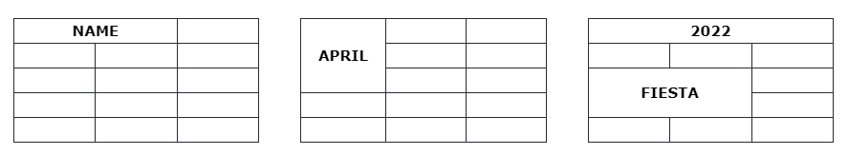
HTML Table Colspan & Rowspan
To make a cell span over multiple columns, use the colspan and rowspan attribute
<table>
<tr> <th colspan="2">Name</th> <th>Age</th> </tr> <tr> <th>Name</th> <td>Jill</td> </tr> <tr> <th rowspan="2">Phone</th> <td>555-1234</td> </tr> <tr> <td>555-8745</td> </tr> </table>

Slide 24
Here the first row is the table header cells:
<table>
<colgroup> <col span="2" style="background-color:Blue"> <col style="background-color:yellow"> </colgroup> <tr> <th>First Member</th> <th>Second Member</th> <th>Third Member</th> </tr> <tr> <td>EMILI</td> <td>JACK</td> <td>ROCK</td> </tr> <tr> <td>27</td> <td>32</td> <td>19</td> </tr> </table>

Slide 25
Html Table Borders :
Html tables can have borders of different styles and shapes.
To add border, we can use the border property on table, th, and td element:
Collapsed Table border:
To avoid having double border
Rounded Table borders:
By using the border-radius property you can make the border corners rounded.
Style Table Borders:
We can set the background color of each cell ,can give the border a different
color (white to make the background invisible as the web page is of white)
Example:
table, th, td { border: 1px solid white; border-collapse: collapse;
border-radius:10px; } th, td { background-color: #96D4D4; }
You can also change the size,height of the table as well :
<table style="width:100%"
style="height:200px" text-align: left;>
More styles in order to change the border:
dotted
dashed EXAMPLE th, td{border-style: dotted;}
solid
double
groove
ridge
inset
outset
none
hidden

Slide 26
The <div> Element(Block-level Element)
The <div> element is often used as a container for other HTML elements.
The <div> element has no required attributes, but style, class and id are common.
When used together with CSS, the <div> element can be used to style blocks of content:
<div style="background-color:black;color:white;padding:20px;"> <h2>Artificial Intelligence</h2> <p>Most people are not very familiar with the concept of artificial intelligence (AI). As an illustration, when 1,500 senior business leaders in the United States in 2017 were asked about AI, only 17 percent said they were familiar with it.¹ A number of them were not sure what it was or how it would affect their particular companies. They understood there was considerable potential for altering business processes, but were not clear how AI could be deployed within their own organizations.<p> </div>
The <span> Elements (Inline Elements)
An inline element does not start on a new line.
An inline element only takes up as much width as necessary.
This is a <span> element inside a paragraph.
The <span> element is an inline container used to mark up a part of a text, or a part of a document.
The <span> element has no required attributes, but style, class and id are common.
When used together with CSS, the <span> element can be used to style parts of the text:
<p> They understood there<span style="color:blue;font-weight:bold;"> was considerable potential for altering</span> business processes,organizations. <span style="color:darkolivegreen;font-weight:bold;"> but were not clear how AI could be deployed within their own </span></p>

Slide 27
The syntax for id is: write a hash character (#), followed by an id name. In the following example we have an <h1> element that points to the id name "myHeader". This <h1> element will be styled according to the #myHeader style definition in the head section:
HTML class Attribute
The HTML class attribute is used to specify a class for an HTML element.
Multiple HTML elements can share the same class.
The class attribute is often used to point to a class name in a style sheet. It can also be used by a JavaScript to access and manipulate elements with the specific class name.
In the following example we have three <div> elements with a class attribute with the value of "city".
All of the three <div> elements will be styled equally according to the .city style definition in the head section
<h2 class="city">London</h2>
Different elements are having the same class <h2 class="city">Paris</h2> <p class="city">Paris is the capital of France</p>
JavaScript can access elements with a specific class name with the getElementsByClassName() method
The id Attribute
The id attribute of an HTML tag can be used to uniquely identify any element within an HTML page.
There are two primary reasons that you might want to use an id attribute on an element:
If an element carries an id attribute as a unique identifier it is possible to identify just that element and its content.
If you have two elements of the same name within a Web page (or style sheet), you can use the id attribute to distinguish between elements that have the same name.
(write a hash character (#), followed by an id name
id name "myHeader”)
Example
<p id="html"> Simple HTML Text</p>
<p id="css">HTML with Cascading Style Sheet properties</p>
A class name can be used by multiple HTML elements, while an id name must only be used by one HTML element within the page

Slide 28
<!DOCTYPE html>
<html>
<head>
<style>
#myHeader {
background-color: lightblue;
color: black;
padding: 40px;
text-align: center;
}
</style>
</head>
<body>
<h2>The id Attribute</h2>
<p>Use CSS to style an element with the id "myHeader":</p>
<h1 id="myHeader">My Header</h1>
</body>
</html>

Slide 29
<h2 class="city">Paris</h2> <p>Paris is the capital of France.</p>
<h2 class="city">Tokyo</h2> <p>Tokyo is the capital of Japan.</p>
<style> /* Style the element with the id "myHeader" */ #myHeader { background-color: lightblue; color: black; padding: 40px; text-align: center; } /* Style all elements with the class name "city" */ .city { background-color: tomato; color: white; padding: 10px; } </style>
<!-- An element with a unique id --> <h1 id="myHeader">My Cities</h1>
<!-- Multiple elements with same class --> <h2 class="city">London</h2> <p>London is the capital of England.</p> <h2 class="city">Paris</h2> <p>Paris is the capital of France.</p>

Slide 30
HTML FORMS:
An HTML form is used to collect user input. The user input is most often sent to a server for processing. The <form> element is a container for different types of input elements,
such as: text fields, checkboxes, radio buttons, submit buttons, etc.
The <input> Element
The HTML <input> element is the most used form element.
An <input> element can be displayed in many ways, depending on the type attribute.
The <label> Element
Notice the use of the <label> element in the example above.
The <label> tag defines a label for many form elements.
The <label> element is useful for screen-reader users, because the screen-reader will read out loud the label when the user focuses on the input element.
The <label> element also helps users who have difficulty clicking on very small regions (such as radio buttons or checkboxes) - because when the user clicks
the text within the <label> element, it toggles the radio button/checkbox.
The for attribute of the <label> tag should be equal to the id attribute of the <input> element to bind them together.
<input type="text"> | Displays a single-line text input field
<input type="radio"> | Displays a radio button (for selecting one of many choices)
<input type="checkbox"> | Displays a checkbox (for selecting zero or more of many choices)
<input type="submit"> | Displays a submit button (for submitting the form)
<input type="button"> | Displays a clickable button

Slide 31
<p>Choose your favorite Web language:</p> <form> <input type="radio" id="html" name="fav_language" value="HTML"> <label for="html">HTML</label><br> <input type="radio" id="css" name="fav_language" value="CSS"> <label for="css">CSS</label><br> <input type="radio" id="javascript" name="fav_language" value="JavaScript"> <label for="javascript">JavaScript</label> </form>

Slide 32
HTML <textarea> Tag
The <textarea> tag defines a multi-line text input control.
The <textarea> element is often used in a form, to collect user inputs like comments or reviews.
A text area can hold an unlimited number of characters, and the text renders in a fixed-width font (usually Courier).
The size of a text area is specified by the cols and rows attributes (or with CSS).
<label for="Textarea">Name Attribute and Id Attribute</label>
<textarea id="Textarea" name="Textarea" rows="4" cols="50">
The name attribute is needed to reference the form data after the form is submitted (if you omit the name attribute, no data from the text area will be submitted) and The id attribute is needed to associate the text area with a label.
</textarea>

Slide 33
<!DOCTYPE html>
<html>
<head>
<style>
textarea {
resize: none;
}
</style>
</head>
<body>
<h1>The textarea element - Disable default resize option</h1>
<p><label for="Textarea">Name Attribute and Id Attribute:</label></p>
<textarea id="w3review" name="w3review" rows="4" cols="50">
The name attribute is needed to reference the form data after the form is submitted (if you omit the name attribute, no data from the text area will be submitted) and The id attribute is needed to associate the text area with a label.
</textarea>
</body>
</html>

Slide 34
Html <nav> tag:
The <nav> tag defines the set of navigation links.
It only intended for major block of navigation links.
<nav>
<a href=”.....”>HTML</a>
<a href=”.....”>CSS</a>
<a href=”.....”>JAVA</a>
<a href=”.....”>PYTHON</a>
</nav>
nav {
display: block;
}

Slide 35
The Action Attribute
The action attribute defines the action to be performed when the form is submitted.
Usually, the form data is sent to a file on the server when the user clicks on the submit button.
<form action="/action_page.php"> <label for="fname">First name:</label><br> <input type="text" id="fname" name="fname" value="John"><br> <label for="lname">Last name:</label><br> <input type="text" id="lname" name="lname" value="Doe"><br><br> <input type="submit" value="Submit"> </form>
The Target Attribute
The target attribute specifies where to display the response that is received after submitting the form.
The target attribute can have one of the following values:
<form action="/action_page.php" target="_blank">
The Method Attribute
The method attribute specifies the HTTP method to be used when submitting the form data.
The form-data can be sent as URL variables (with method="get") or as HTTP post transaction (with method="post").
The default HTTP method when submitting form data is GET.
<form action="/action_page.php" method="get">
<form action="/action_page.php" method="post">
The Autocomplete Attribute
The autocomplete attribute specifies whether a form should have autocomplete on or off.
When autocomplete is on, the browser automatically complete values based on values that the user has entered before.
<form action="/action_page.php" autocomplete="on">
The Novalidate Attribute
The novalidate attribute is a boolean attribute.
When present, it specifies that the form-data (input) should not be validated when submitted.
<form action="/action_page.php" novalidate>

Slide 36
The <select> Element
The <select> element defines a drop-down list:
The <option> element defines an option that can be selected.
By default, the first item in the drop-down list is selected.
To define a pre-selected option, add the selected attribute to the option
<label for="cars">Choose a car:</label> <select id="cars" name="cars"> <option value="volvo">Volvo</option> <option value="saab">Saab</option> <option value="fiat">Fiat</option> <option value="audi">Audi</option> </select>

Slide 37
HTML Video
The HTML <video> element is used to show a video on a web page.
To show a video in HTML, use the <video> element:
<video width="320" height="240" controls>
<source src="movie.mp4" type="video/mp4">
<source src="movie.ogg" type="video/ogg">
Your browser does not support the video tag.
</video>
The controls attribute adds video controls, like play, pause, and volume.
It is a good idea to always include width and height attributes. If height and width are not set, the page might flicker while the video loads.
The <source> element allows you to specify alternative video files which the browser may choose from. The browser will use the first recognized format.
The text between the <video> and </video> tags will only be displayed in browsers that do not support the <video> element.

Slide 38
HTML Audio
To play an audio file in HTML, use the <audio> element:The controls attribute adds audio controls, like play, pause, and volume.
<audio controls>
<source src="horse.ogg" type="audio/ogg">
<source src="horse.mp3" type="audio/mpeg">
Your browser does not support the audio element.
</audio>
The <source> element allows you to specify alternative audio files which the browser may choose from. The browser will use the first recognized format.
The text between the <audio> and </audio> tags will only be displayed in browsers that do not support the <audio> element.

Slide 39
HTML YouTube Videos
The easiest way to play videos in HTML, is to use YouTube.
Converting videos to different formats can be difficult and time-consuming.
An easier solution is to let YouTube play the videos in your web page.
An HTML iframe is used to display a web page within a web page.
The HTML <iframe> tag specifies an inline frame.
An inline frame is used to embed another document within the current HTML document.
<iframe src="url" title="description"></iframe>
Example :
<iframe width="420" height="315"
src="https://www.youtube.com/embed/tgbNymZ7vqY">
</iframe>

Slide 40
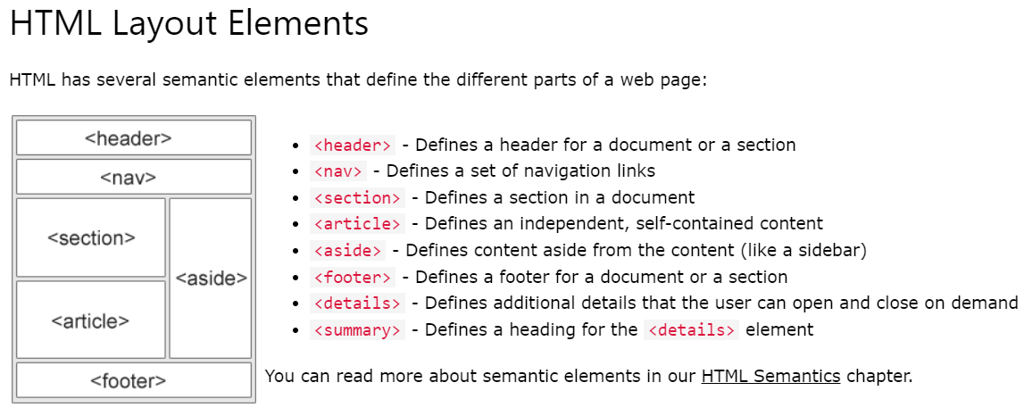

Slide 41
Task: Create a Registration Form Requirements:
Design a registration form with the following fields:
Name (text input)
Email (email input)
Password (password input)
Confirm Password (password input)
Gender (radio buttons for Male/Female/Other)
Country (dropdown/select menu)
Terms and Conditions (checkbox)
Submit Button
Apply basic styling to make the form visually appealing

Slide 42
CSS
CSS stands for Cascading Style Sheets.
CSS is the language we use to style an HTML document.
CSS3 is the latest version of the CSS specification.
CSS3 adds several new styling features and improvements to enhance the web presentation capabilities.
CSS describes how HTML elements should be displayed.
CSS can be added to HTML documents in 3 ways:
Inline - by using the style attribute inside HTML elements.
Internal - by using a <style> element in the <head> section.
External - by using a <link> element to link to an external CSS file.

Slide 43
What You Can Do with CSS
You can easily apply same style rules on multiple elements.
You can control the presentation of multiple pages of a website
with a single style sheet.
You can present the same page differently on different devices.
You can style dynamic states of elements such as hover, focus, etc.
that isn't possible otherwise.
You can change the position of an element on a web page without
changing the markup.
You can alter the display of existing HTML elements.
You can transform elements like scale, rotate, skew, etc. in 2D or 3D space.
You can create animations and transitions effects without using
any JavaScript.

Slide 44
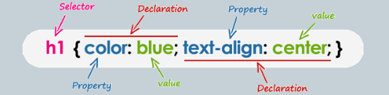
CSS Syntax
A CSS rule consists of a selector and a declaration block.
The selector points to the HTML element you want to style.
The declaration block contains one or more declarations separated by semicolons.
Each declaration includes a CSS property name and a value, separated by a colon.
Multiple CSS declarations are separated with semicolons, and declaration blocks are surrounded by curly braces.

Slide 45
selector { Declaration;Declaration}
p {
color: red;
text-align: center;
}
p is a selector in CSS (it points to the HTML element you want to style: <p>).
color is a property, and red is the property value
text-align is a property, and center is the property value

Slide 46
Inline CSS
An inline CSS is used to apply a unique style to a single HTML element.
An inline CSS uses the style attribute of an HTML element.
The following example sets the text color of the <h1> element to blue, and the text color of the <p> element to red:
<h1 style="color:blue;">A Blue Heading</h1>
<p style="color:red;">A red paragraph.</p>

Slide 47
Internal CSS
An internal CSS is used to define a style for a single HTML page.
An internal CSS is defined in the <head> section of an HTML page, within a <style> element.
The following example sets the text color of ALL the <h1> elements (on that page) to blue, and the text color of ALL the <p> elements to red. In addition, the page will be displayed with a "powderblue" background color:
<!DOCTYPE html> <html>
<head>
<style>
body {background-color: powderblue;}
h1 {color: blue;}
p {color: red;}
</style> </head>
<body>
<h1>This is a heading</h1>
<p>This is a paragraph.</p>
</body></html>

Slide 48
External CSS
An external style sheet is used to define the style for many HTML pages.
To use an external style sheet, add a link to it in the <head> section of each HTML page:
<!DOCTYPE html>
<html>
<head>
<link rel="stylesheet" href="styles.css">
</head>
<body>
<h1>This is a heading</h1>
<p>This is a paragraph.</p>
</body>
</html>

Slide 49
The external style sheet can be written in any text editor. The file must not contain any HTML code, and must be saved with a .css extension.
Here is what the "styles.css" file looks like:
body {
background-color: powderblue;
}
h1 {
color: blue;
}
p {
color: red;
}

Slide 50
CSS Backgrounds
The CSS background properties are used to add background effects for elements.
CSS background-color:
The background-color property specifies the background color of an element :
body {
background-color: lightblue;
}
Opacity / Transparency:
The opacity property specifies the opacity/transparency of an element. It can take a value from 0.0 - 1.0. The lower value, the more transparent:
div {
background-color: green;
opacity: 0.3;
}

Slide 51
CSS background-image:
The background-image property specifies an image to use as the background of an element.
body {
background-image: url("bgdesert.jpg");
background-position: right top;
background-attachment: fixed;
background-attachment: scroll;
}

Slide 52
CSS Box Model
In CSS, the term "box model" is used when talking about design and layout.
The CSS box model is essentially a box that wraps around every HTML element. It consists of: margins, borders, padding, and the actual content.
Explanation of the different parts:
Content - The content of the box, where text and images appear
Padding - Clears an area around the content. The padding is transparent
Border - A border that goes around the padding and content
Margin - Clears an area outside the border. The margin is transparent

Slide 53
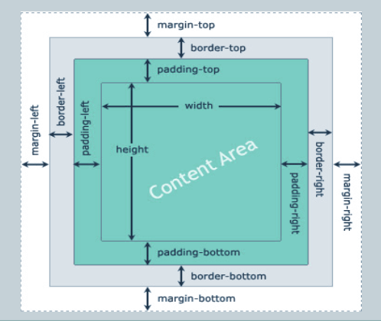

Slide 54
CSS Box Model
div {
width: 300px;
border: 15px solid green;
padding: 50px;
margin: 20px;
}

Slide 55
JavaScript
JavaScript was initially created to “make web pages alive”.
The programs in this language are called scripts. They can be written right in a web page’s HTML and run automatically as the page loads.
Scripts are provided and executed as plain text. They don’t need special preparation or compilation to run.
In this aspect, JavaScript is very different from another language called Java.
Today, JavaScript can execute not only in the browser, but also on the server, or actually on any device that has a special program called the JavaScript engine.
The browser has an embedded engine sometimes called a “JavaScript virtual machine”.

Slide 56
JAVASCRIPT SYNTAX
JavaScript programs can be inserted almost anywhere into an HTML document (HEAD & BODY)using the <script> tag.
The type and language attributes are not required.
A script in an external file can be inserted with <script src="path/to/script.js"></script>.
EXAMPLE:
<!DOCTYPE HTML>
<html>
<body>
<p>Before the script...</p>
<script>
alert( 'Hello, world!' );
</script>
<p>...After the script.</p>
</body>
</html>

Slide 57
JavaScript Output
JavaScript can "display" data in different ways:
Writing into an HTML element, using innerHTML.
Writing into the HTML output using document.write().
Writing into an alert box, using alert().
Writing into the browser console, using console.log().

Slide 58
Using innerHTML
To access an HTML element, JavaScript can use the document.getElementById(id) method.
The id attribute defines the HTML element. The innerHTML property defines the HTML content:
<!DOCTYPE html>
<html>
<body>
<h1>My First Web Page</h1>
<p>My First Paragraph</p>
<p id="demo"></p>
<script>
document.getElementById("demo").innerHTML = 5 + 6;
</script>
</body>
</html>

Slide 59
Using document.write()
<!DOCTYPE html>
<html>
<body>
<h1>My First Web Page</h1>
<p>My first paragraph.</p>
<script>
document.write(5 + 6);
</script>
</body>
</html>

Slide 60
Task :
Create a button named : “Click Me” and on clicking the button should disappear and the following content should be displayed “ This is the information i got after clicking on button “

Slide 61
Solution:
<!DOCTYPE html>
<html>
<body>
<button type="button" onclick=’document.write(“This is the information i got after clicking on button”)’>Click Me</button>
</body>
</html>

Slide 62
JavaScript Print
JavaScript does not have any print object or print methods.
You cannot access output devices from JavaScript.
The only exception is that you can call the window.print() method in the browser to print the content of the current window.
<!DOCTYPE html>
<html>
<body>
<button onclick="window.print()">Print this page</button>
</body>
</html>

Slide 63
Functions
Functions are the main “building blocks” of the program. They allow the code to be called many times without repetition.
We’ve already seen examples of built-in functions, like alert(message), prompt(message, default) and confirm(question). But we can create functions of our own as well.
Function Declaration
To create a function we can use a function declaration.
function showMessage() {
alert( 'Hello everyone!' );
}

Slide 64
The function keyword goes first, then goes the name of the function, then a list of parameters between the parentheses (comma-separated, empty in the example ) and finally the code of the function, also named “the function body”, between curly braces.

Slide 65
VARIABLES
Most of the time, a JavaScript application needs to work with information. Here are two examples:
An online shop – the information might include goods being sold and a shopping cart.
A chat application – the information might include users, messages, and much more.
Variables are used to store this information.
A variable is a “named storage” for data. We can use variables to store goodies, visitors, and other data.
To create a variable in JavaScript, use the let keyword.
The statement below creates (in other words: declares) a variable with the name “message”:
let message;

Slide 66
Constants:
To declare a constant (unchanging) variable, use const instead of let:
const myBirthday = '18.04.1982';
Variables declared using const are called “constants”. They cannot be reassigned. An attempt to do so would cause an error:
const myBirthday = '18.04.1982';
myBirthday = '01.01.2001'; // error, can't reassign the constant!
When a programmer is sure that a variable will never change, they can declare it with const to guarantee and clearly communicate that fact to everyone.

Slide 67
SCOPE
Scope determines the accessibility (visibility) of variables.
Before ES6 (2015), JavaScript had only Global Scope and Function Scope(local scope)
ES6 introduced two important new JavaScript keywords: let and const.
These two keywords provide Block Scope in JavaScript.

Slide 68
JavaScript has 3 types of scope:
Block scope
Function scope
Global scope
1. Block Scope:
Variables declared inside a { } block cannot be accessed from outside the block:
Variables declared with the var keyword can NOT have block scope.
Variables declared inside a { } block can be accessed from outside the block.
EXAMPLE: {
var x = 2;
}
// x CAN be used here

Slide 69
2. Local Scope
Variables declared within a JavaScript function, become LOCAL to the function , i.e it can only be accessed within a function.
Example:
let a = "hello";
function greet()
{
let b = "World"
console.log(a + b);
}
greet();
console.log(a + b); // error
In the above program, variable a is a global variable and variable b is a local variable. The variable b can be accessed only inside the function greet. Hence, when we try to access variable b outside of the function, an error occurs.

Slide 70
let is Block Scoped:
The let keyword is block-scoped (variable can be accessed only in the immediate block).
Example:
// global variable
let a = 'Hello';
function greet() {
let b = 'World'; // local variable
console.log(a + ' ' + b);
if (b == 'World') {
let c = 'hello'; // block-scoped variable
console.log(a + ' ' + b + ' ' + c);
}
console.log(a + ' ' + b + ' ' + c); // variable c cannot be accessed here
}
greet();

Slide 71
In the above program, variable
a is a global variable. It can be accessed anywhere in the program.
b is a local variable. It can be accessed only inside the function greet.
c is a block-scoped variable. It can be accessed only inside the if statement block.
Hence, in the above program, the first two console.log() work without any issue.
However, we are trying to access the block-scoped variable c outside of the block in the third console.log(). This will throw an error.

Slide 72
3. GLOBAL SCOPE
A variable declared at the top of a program or outside of a function is considered a global scope variable.
Example:
let a = "hello";
function greet () {
console.log(a);
}
greet(); // hello
In the above program, variable a is declared at the top of a program and is a global variable. It means the variable a can be used anywhere in the program.

Slide 73
Note: It is a good practice to avoid using global variables because the value of a global variable can change in different areas in the program. It can introduce unknown results in the program.
In JavaScript, a variable can also be used without declaring it. If a variable is used without declaring it, that variable automatically becomes a global variable.

Slide 74
JAVASCRIPT DATATYPES
A value in JavaScript is always of a certain type. For example, a string or a number.
There are eight basic data types in JavaScript.
We can put any type in a variable. For example, a variable can at one moment be a string and then store a number:
let message = "hello";
message = 123456;
Programming languages that allow such things, such as JavaScript, are called “dynamically typed”, meaning that there exist data types, but variables are not bound to any of them.

Slide 75
Seven primitive data types:
number for numbers of any kind: integer or floating-point, integers are limited by ±(253-1).
bigint for integer numbers of arbitrary length.
string for strings. A string may have zero or more characters, there’s no separate single-character type.
boolean for true/false.
null for unknown values – a standalone type that has a single value null.
undefined for unassigned values – a standalone type that has a single value undefined.
symbol for unique identifiers.
And one non-primitive data type:
object for more complex data structures.

Slide 76
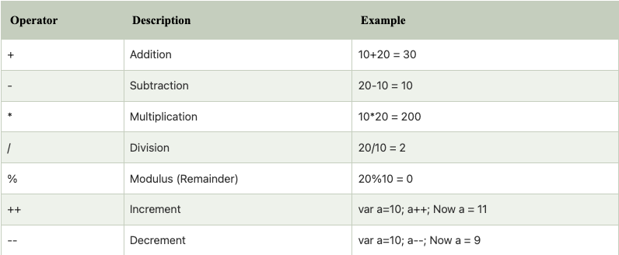
OPERATORS
An operand – is what operators are applied to. For instance, in the multiplication of 5 * 2 there are two operands: the left operand is 5 and the right operand is 2. Sometimes, people call these “arguments” instead of “operands”.
ARITHEMATIC OPERATORS:

Slide 77
Arithematic
<!DOCTYPE html>
<html>
<body>
<p id="demo"></p>
<script>
let x = 100 + 50;
document.getElementById("demo").innerHTML = x;
</script>
</body>
</html>

Slide 78
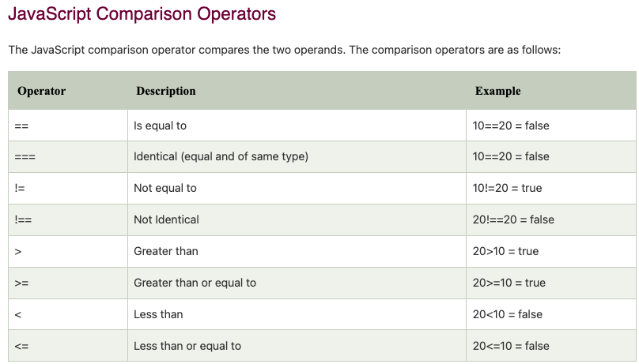

Slide 79
Example:
<!DOCTYPE html> <html> <body>
<p>Assign 5 to x, and display the value of the comparison (x == 5):</p>
<p>Assign 5 to x, and display the value of the comparison (x === "5").</p>
<p id="demo"></p>
<script>
let x = 5;
document.getElementById("demo").innerHTML = (x == "5");
document.getElementById("demo").innerHTML = (x === "5");
</script></body></html>

Slide 80
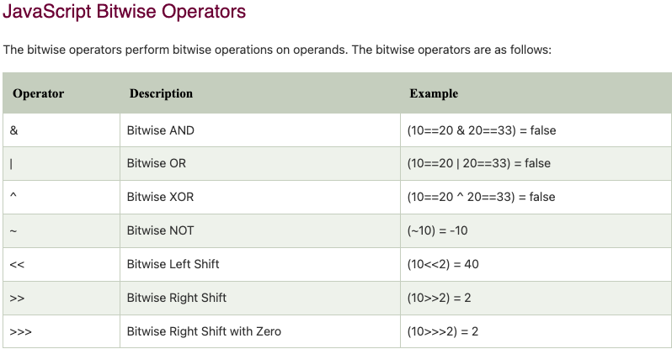

Slide 81
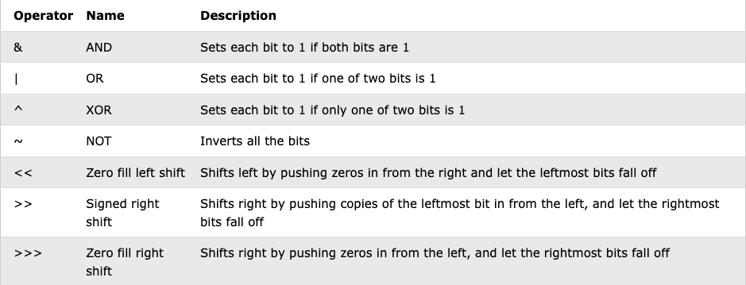

Slide 82
Example:
<!DOCTYPE html>
<html>
<body>
<h1>JavaScript Bitwise AND</h1>
<h2>The & Operator</h2>
<p id="demo"></p>
<script>
document.getElementById("demo").innerHTML = 5 & 1;
document.getElementById("demo").innerHTML = 5 | 1;
document.getElementById("demo").innerHTML = 5 ^ 1;
</script> </body> </html>

Slide 83
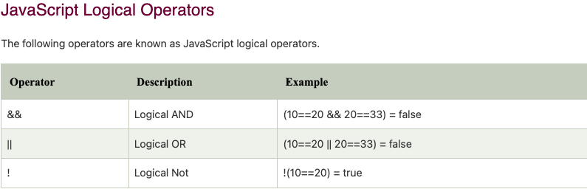

Slide 84
Example:
<!DOCTYPE html> <html> <body>
<h2>The && Operator (Logical AND)</h2>
<p>The && operator returns true if both expressions are true, otherwise it returns false.</p>
<p id="demo"></p>
<script>
let x = 6;
let y = 3;
document.getElementById("demo").innerHTML =
(x < 10 && y > 1) + "<br>" +
(x < 10 && y < 1);
</script> </body> </html>

Slide 85
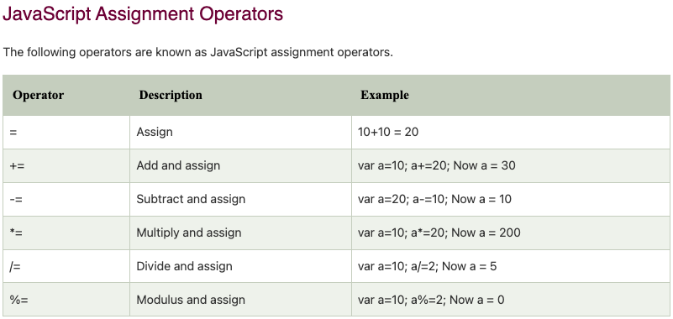

Slide 86
Recursive function
<script>
// program to count down numbers to 1
function countDown(number) {
// display the number
document.write(number, "<br>");
// decrease the number value
const newNumber = number - 1;
// base case
if (newNumber > 0) {
countDown(newNumber);
}
}
countDown(4);
</script>

Slide 87
Events
An HTML event can be something the browser does, or something a user does.
Here are some examples of HTML events:
An HTML web page has finished loading
An HTML input field was changed
An HTML button was clicked
Often, when events happen, you may want to do something.
JavaScript lets you execute code when events are detected.

Slide 88
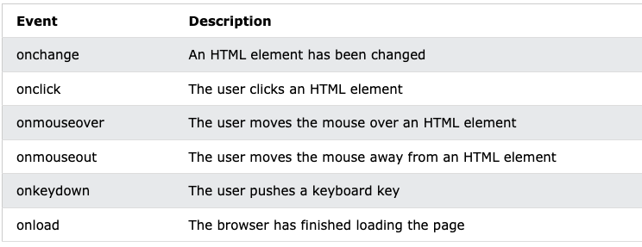
Common HTML Events
Here is a list of some common HTML events:

Slide 89
Java Script Function Example :
<html>
<head> <title>Add function</title> </head>
<body onload="add()"> // Execute a JavaScript immediately after a page has been loaded
<script>
var i=Number(prompt("Enter 1st variable"));
var j=Number(prompt("enter 2nd varialbe"));
function add()
{
document.write("the sum is ",(i+j));
}
</script>
</body>
</html>

Slide 90
Javascript Event Example:
<html>
<input type="button" value="Hover" id="btn"
onmouseover="this.style.background='red'; this.style.color='yellow'"
onmouseout="this.style.background='cadetblue'; this.style.color='white'"/>
</html>

Slide 91
Javascript Example 2 :
<html> <input type="button" value="Click me" id="btn"
onmouseover="changeColorOnMouseOver(this)"
onmouseout="changeColorOnMouseOut(this)"/>
<script type="text/javascript">
function changeColorOnMouseOver(x)
{
x.style.background='red';
x.style.color='yellow';
}
function changeColorOnMouseOut(x)
{
x.style.background='cadetblue';
x.style.color='white';
}
</script>
</html>

Slide 92
JavaScript Arrow Function
Arrow function is one of the features introduced in the ES6 version of JavaScript. It allows you to create functions in a cleaner way compared to regular functions. For example,
This function
// function expression
let x = function(x, y) {
return x * y;
}
can be written as
// using arrow functions
let x = (x, y) => x * y;
using an arrow function.

Slide 93
Arrow Function Syntax
The syntax of the arrow function is:
let myFunction = (arg1, arg2, ...argN) => {
statement(s)
}
Here,myFunction is the name of the function arg1, arg2, ...argN are the function argumentsstatement(s) is the function body
If the body has single statement or expression, you can write arrow function as:
let myFunction = (arg1, arg2, ...argN) => expression

Slide 94
Java Script Objects
As we know from the chapter Data types, there are eight data types in JavaScript. Seven of them are called “primitive”, because their values contain only a single thing (be it a string or a number or whatever).
In contrast, objects are used to store keyed collections of various data and more complex entities. In JavaScript, objects penetrate almost every aspect of the language. So we must understand them first before going in-depth anywhere else.
An object can be created with figure brackets {…} with an optional list of properties. A property is a “key: value” pair, where key is a string (also called a “property name”), and value can be anything.
We can imagine an object as a cabinet with signed files. Every piece of data is stored in its file by the key. It’s easy to find a file by its name or add/remove a file.

Slide 95
An empty object (“empty cabinet”) can be created using one of two syntaxes:
let user = new Object(); // "object constructor" syntax
let user = {}; // "object literal" syntax
Usually, the figure brackets {...} are used. That declaration is called an object literal.

Slide 96
JavaScript object is a non-primitive data-type that allows you to store multiple collections of data.
Note: If you are familiar with other programming languages, JavaScript objects are a bit different. You do not need to create classes in order to create objects.
Example:
// object
const student = {
firstName: 'ram',
class: 10
};
Here, student is an object that stores values such as strings and numbers.

Slide 97
JavaScript Object Declaration
The syntax to declare an object is:
const object_name = {
key1: value1,
key2: value2 }
Accessing Object Properties:
You can access the value of a property by using its key.
1. Using dot Notation
Here's the syntax of the dot notation.
objectName.key
2. Using bracket Notation
Here is the syntax of the bracket notation.
objectName["propertyName"]

Slide 98
JavaScript Methods and this Keyword
In JavaScript, objects can also contain functions. For example,
// object containing method
const person = {
name: 'John',
greet: function() { console.log('hello'); }
};
In the above example, a person object has two keys (name and greet), which have a string value and a function value, respectively.
Hence basically, the JavaScript method is an object property that has a function value.

Slide 99
Accessing Object Methods
You can access an object method using a dot notation. The syntax is: objectName.methodKey()
You can access property by calling an objectName and a key. You can access a method by calling an objectName and a key for that method along with (). For example,
// accessing method and property
const person = {
name: 'John',
greet: function() { console.log('hello'); }
};
// accessing property
person.name; // John
// accessing method
person.greet(); // hello
Here, the greet method is accessed as person.greet() instead of person.greet.
If you try to access the method with only person.greet, it will give you a function definition.

Slide 100
JavaScript this Keyword
To access a property of an object from within a method of the same object, you need to use the this keyword. Let's consider an example.
const person = {
name: 'John',
age: 30,
// accessing name property by using this.name
greet: function() { console.log('The name is' + ' ' + this.name); }
};
person.greet();

Slide 101
In the above example, a person object is created. It contains properties (name and age) and a method greet.
In the method greet, while accessing a property of an object, this keyword is used.
In order to access the properties of an object, this keyword is used following by . and key.
Note: In JavaScript, this keyword when used with the object's method refers to the object. this is bound to an object.

Slide 102
Literals and properties
We can immediately put some properties into {...} as “key: value” pairs:
let user = { // an object
name: "John", // by key "name" store value "John"
age: 30 // by key "age" store value 30
};
A property has a key (also known as “name” or “identifier”) before the colon ":" and a value to the right of it.
In the user object, there are two properties:
The first property has the name "name" and the value "John".
The second one has the name "age" and the value 30.

Slide 103
We can add, remove and read files from it at any time.
Property values are accessible using the dot notation:
// get property values of the object:
alert( user.name ); // John
alert( user.age ); // 30
The value can be of any type. Let’s add a boolean one:
user.isAdmin = true;
To remove a property, we can use the delete operator:
delete user.age;
We can also use multiword property names, but then they must be quoted:
let user = {
name: "John",
age: 30,
"likes birds": true // multiword property name must be quoted
};

Slide 104
The last property in the list may end with a comma:
let user = {
name: "John",
age: 30,
}
That is called a “trailing” or “hanging” comma. Makes it easier to add/remove/move around properties, because all lines become alike.

Slide 105
JavaScript Constructor Function
In JavaScript, a constructor function is used to create objects. For example,
/ constructor function
function Person () {
this.name = 'John',
this.age = 23
}
// create an object
const person = new Person();
In the above example, function Person() is an object constructor function.
To create an object from a constructor function, we use the new keyword.

Slide 106
JavaScript this Keyword
In JavaScript, when this keyword is used in a constructor function, this refers to the object when the object is created. For example,
// constructor function
function Person () {
this.name = 'John',
}
// create object
const person1 = new Person();
// access properties
console.log(person1.name); // John
Hence, when an object accesses the properties, it can directly access the property as person1.name.

Slide 107
Create Objects: Constructor Function Vs Object Literal
Object Literal is generally used to create a single object. The constructor function is useful if you want to create multiple objects. For example,
// using object literal
let person = {
name: 'Sam'
}
// using constructor function
function Person () {
this.name = 'Sam'
}
let person1 = new Person();
let person2 = new Person();

Slide 108
Working With Arrays
An array is an object that can store multiple values at once. For example,
const words = ['hello', 'world', 'welcome'];
Here, words is an array. The array is storing 3 values.
Create an Array:
You can create an array using two ways:
1. Using an array literal
The easiest way to create an array is by using an array literal []. For example,
const array1 = ["eat", "sleep"];

Slide 109
2. Using the new keyword
You can also create an array using JavaScript's new keyword.
const array2 = new Array("eat", "sleep");
In both of the above examples, we have created an array having two elements.
Note: It is recommended to use array literal to create an array.

Slide 110
Here are more examples of arrays:
// empty array
const myList = [ ];
// array of numbers
const numberArray = [ 2, 4, 6, 8];
// array of strings
const stringArray = [ 'eat', 'work', 'sleep'];
// array with mixed data types
const newData = ['work', 'exercise', 1, true];

Slide 111
You can also store arrays, functions and other objects inside an array. For example,
const newData = [
{'task1': 'exercise'},
[1, 2 ,3],
function hello() { console.log('hello')}
];
Access Elements of an Array
You can access elements of an array using indices (0, 1, 2 …). For example,
const myArray = ['h', 'e', 'l', 'l', 'o'];
// first element
console.log(myArray[0]); // "h"
// second element
console.log(myArray[1]); // "e"

Slide 112
Add an Element to an Array
You can use the built-in method push() and unshift() to add elements to an array.
The push() method adds an element at the end of the array. For example,
let dailyActivities = ['eat', 'sleep'];
// add an element at the end
dailyActivities.push('exercise');
console.log(dailyActivities); // ['eat', 'sleep', 'exercise']
The unshift() method adds an element at the beginning of the array. For example,
let dailyActivities = ['eat', 'sleep'];
//add an element at the start
dailyActivities.unshift('work');
console.log(dailyActivities); // ['work', 'eat', 'sleep']

Slide 113
Change the Elements of an Array
You can also add elements or change the elements by accessing the index value.
let dailyActivities = [ 'eat', 'sleep'];
// this will add the new element 'exercise' at the 2 index
dailyActivities[2] = 'exercise';
console.log(dailyActivities); // ['eat', 'sleep', 'exercise']
Remove an Element from an Array
You can use the pop() method to remove the last element from an array. The pop() method also returns the returned value. For example,
let dailyActivities = ['work', 'eat', 'sleep', 'exercise'];
// remove the last element
dailyActivities.pop();
console.log(dailyActivities); // ['work', 'eat', 'sleep']

Slide 114
If you need to remove the first element, you can use the shift() method.
The shift() method removes the first element and also returns the removed element. For example,
let dailyActivities = ['work', 'eat', 'sleep'];
// remove the first element
dailyActivities.shift();
console.log(dailyActivities); // ['eat', 'sleep']
Array length
You can find the length of an element (the number of elements in an array) using the length property. For example,
const dailyActivities = [ 'eat', 'sleep'];
// this gives the total number of elements in an array
console.log(dailyActivities.length); // 2

Slide 115
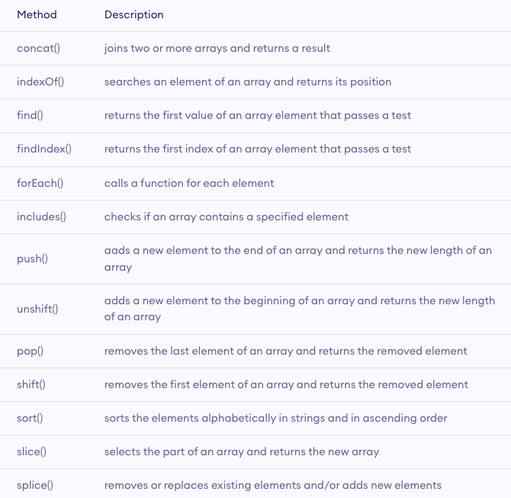
Array Methods

Slide 116
JavaScript Multidimensional Array
A multidimensional array is an array that contains another array. For example,
// multidimensional array
const data = [[1, 2, 3], [1, 3, 4], [4, 5, 6]];
Create a Multidimensional Array:
Example 1
let studentsData = [['Jack', 24], ['Sara', 23], ['Peter', 24]];
Example 2
let student1 = ['Jack', 24];
let student2 = ['Sara', 23];
let student3 = ['Peter', 24];
// multidimensional array
let studentsData = [student1, student2, student3];

Slide 117
Error Handling
Types of Errors
In programming, there can be two types of errors in the code:
Syntax Error: Error in the syntax. For example, if you write consol.log('your result');, the above program throws a syntax error. The spelling of console is a mistake in the above code.
Runtime Error: This type of error occurs during the execution of the program. For example,
calling an invalid function or a variable.
These errors that occur during runtime are called exceptions. Now, let's see how you can handle these exceptions.

Slide 118
JavaScript try...catch Statement
The try...catch statement is used to handle the exceptions. Its syntax is:
try { // body of try }
catch(error) { // body of catch }
The main code is inside the try block. While executing the try block, if any error occurs, it goes to the catch block. The catch block handles the errors as per the catch statements.
If no error occurs, the code inside the try block is executed and the catch block is skipped.

Slide 119
Example 1: Display Undeclared Variable
// program to show try...catch in a program
const numerator= 100, denominator = 'a';
try {
console.log(numerator/denominator);
// forgot to define variable a
console.log(a); }
catch(error) {
console.log('An error caught');
console.log('Error message: ' + error);
}

Slide 120
JavaScript try...catch...finally Statement
You can also use the try...catch...finally statement to handle exceptions. The finally block executes both when the code runs successfully or if an error occurs.
The syntax of try...catch...finally block is:
try { // try_statements}
catch(error) { // catch_statements }
finally() { // codes that gets executed anyway}
Note: You need to use catch or finally statement after try statement. Otherwise, the program will throw an error Uncaught SyntaxError: Missing catch or finally after try.

Slide 121
Example 2: try...catch...finally Example
const numerator= 100, denominator = 'a';
try {
console.log(numerator/denominator);
console.log(a);
}
catch(error) {
console.log('An error caught');
console.log('Error message: ' + error);
}
finally {
console.log('Finally will execute every time');
}

Slide 122
JavaScript throw Statement
In JavaScript, the throw statement handles user-defined exceptions. For example, if a certain number is divided by 0, and if you need to consider Infinity as an exception, you can use the throw statement to handle that exception.
The syntax of throw statement is:
throw expression;
Here, expression specifies the value of the exception.
For example,
const number = 5;
throw number/0; // generate an exception when divided by 0

Slide 123
JavaScript throw with try...catch
The syntax of try...catch...throw is:
try { // body of try
throw exception; }
catch(error) { // body of catch }
Note: When the throw statement is executed, it exits out of the block and goes to the catch block. And the code below the throw statement is not executed.

Slide 124
Example 1: try...catch...throw Example
const number = 40;
try {
if(number > 50) {
console.log('Success');
}
else {
throw new Error('The number is low'); // user-defined throw statement
}
// if throw executes, the below code does not execute
console.log('hello');
}
catch(error) {
console.log('An error caught');
console.log('Error message: ' + error);
}

